Slide 1



Cartoonizer: Image Stylization
TAN James Anthroi A.
CAI Jiayu
ZHOU Zekai
ZHANG Shuang

Slide 2
What is this project?
The Cartoonizer is a Python program that transforms real-world photographs into cartoon-style images. It mimics the artistic style of cartoons by:
Simplifying complex colors into a limited palette
Highlighting bold, clean outlines
Adding subtle sketch-like textures

Slide 3


Table of Contents
Import Libraries
Key Features
Core Image Processing
01
02
03
Utility Functions
Sample Outcomes
Q&A
04
05
06
Libraries we used to create this program
Initialization and UI settings
Main body of the cartoonizer
Extra utility for user preference
Results display

Slide 4
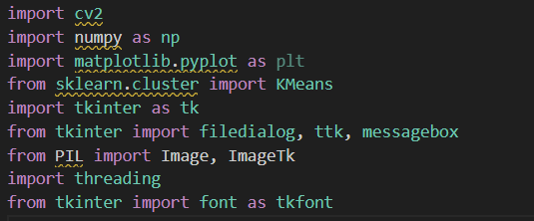
Import Libraries
cv2 (OpenCV) – it handles the image processing tasks
np (NumPy) – manages numerical operations and arrays
matplotlib.pyplot – for displaying images
sklearn.cluster.KMeans – reducing color complexity
tkinter – let the user choose their own image file by opening a file dialog
PIL.Image, PIL.ImageTk —Image processing is compatible with Tkinter
Threading — Prevent the interface from freezing during image processing.

Slide 5
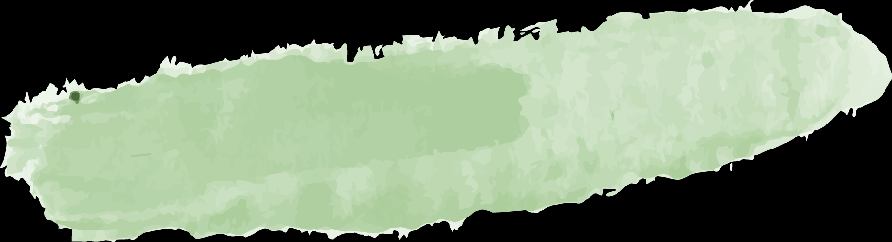
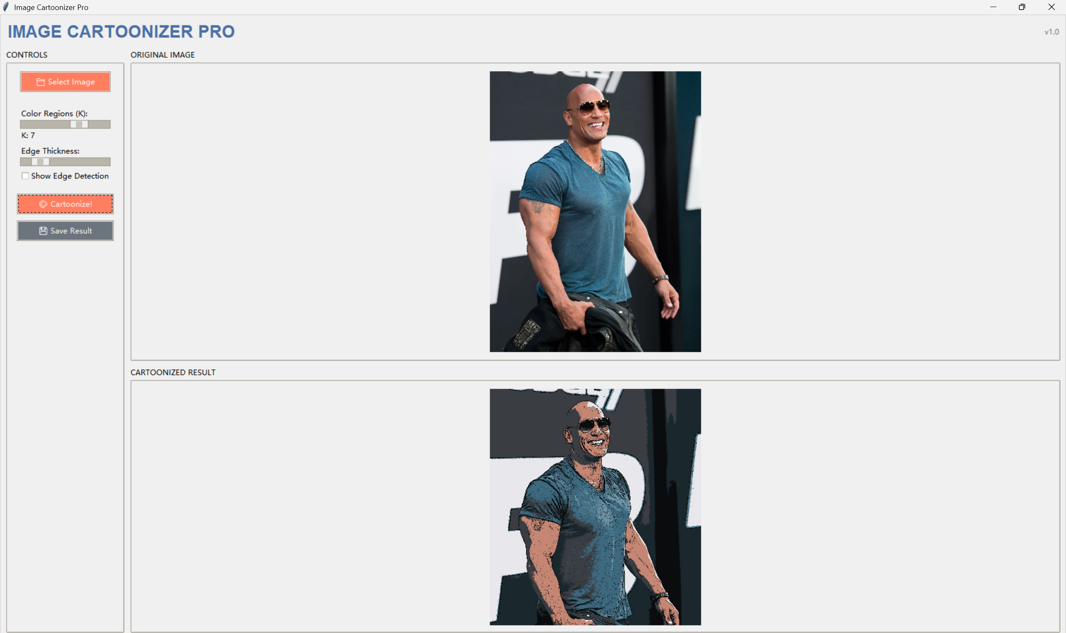



Key Features
01
Intuitive Controls:
Color Regions (K-clusters slider)
Edge Thickness adjustment
Edge preview toggle
02
One-Click Actions:
Cartoonize! / Save Result
Live Previews:
03
Original vs. Output comparison panes

Slide 6
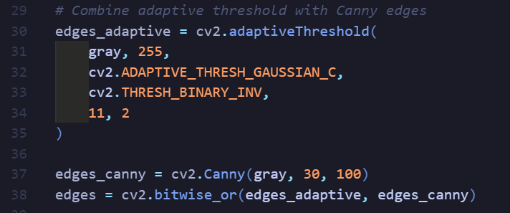
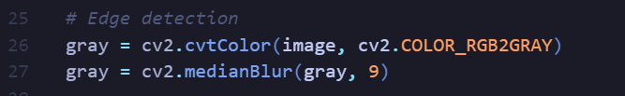
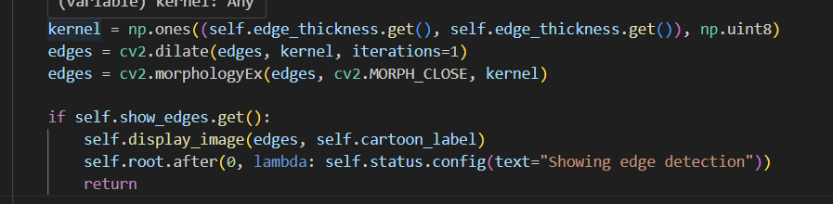
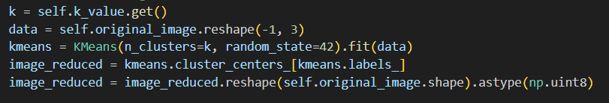
Core Image Processing
Edge Detection
Combine Two Edges
Refine Edges
Color Simplification
highlight the outlines like a cartoon
detect the sharp edges and merge both edge types
Ensures edges are continuous and visually prominent
Flatten color region using k-means clustering

Slide 7
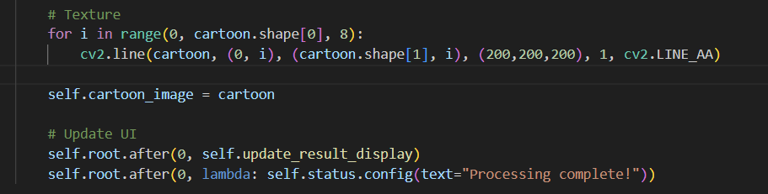
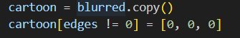
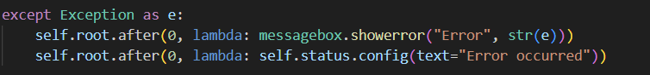
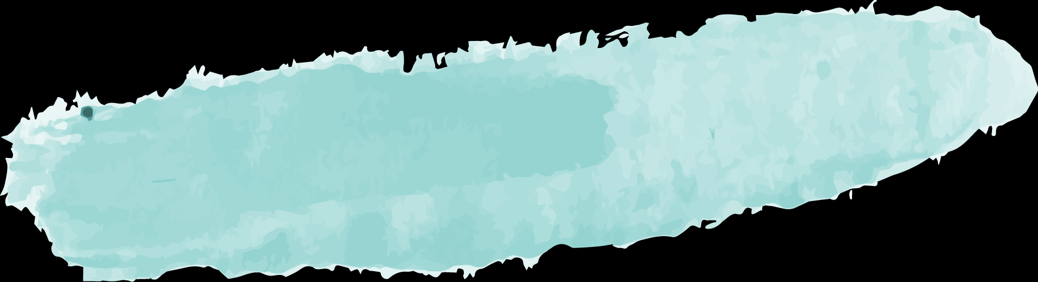
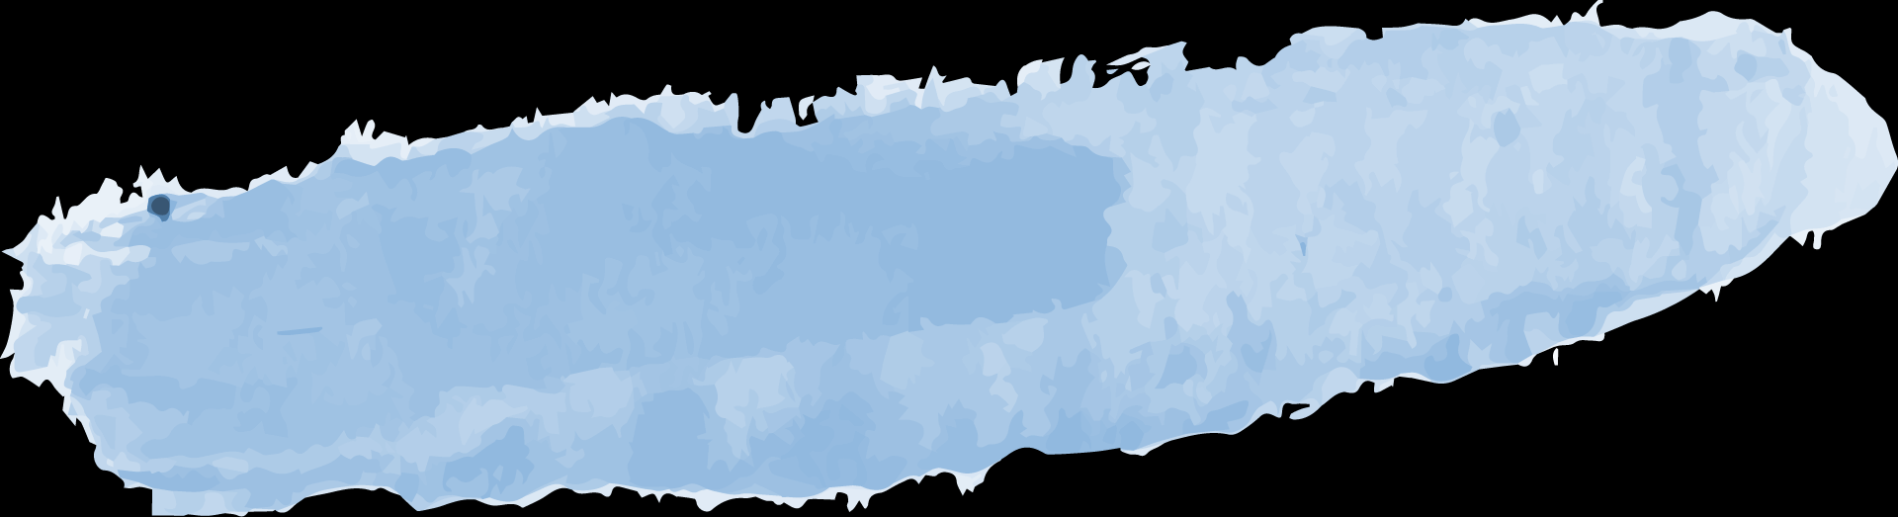
Core Image Processing
Smoothing & Edge Preservation
Cartoon Effect
Display & Save Results
Error handle
Apply black edges to the smoothed image
Apply bilateral filter to smooth while preserving edges.
Draw light gray horizontal lines every 8 pixels & save

Slide 8
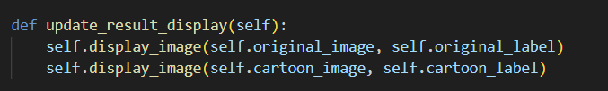
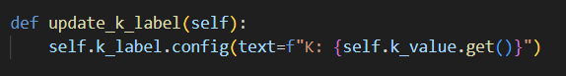
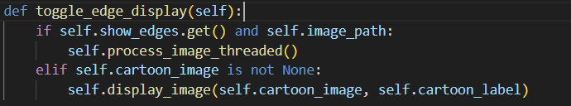
Utility Functions
K – label update
Toggle edge display
Result display update
Updates the K-value slider label in real time
Toggles between edge-only and full cartoonized views
Refreshes both image displays

Slide 9
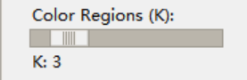
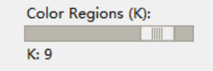
K – label update

Slide 10

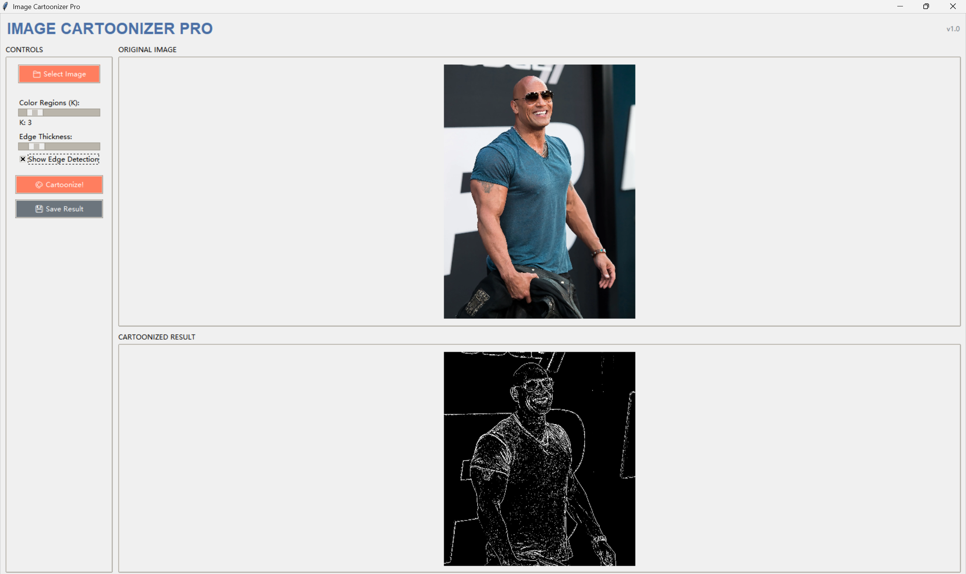
Toggle edge display

Slide 11
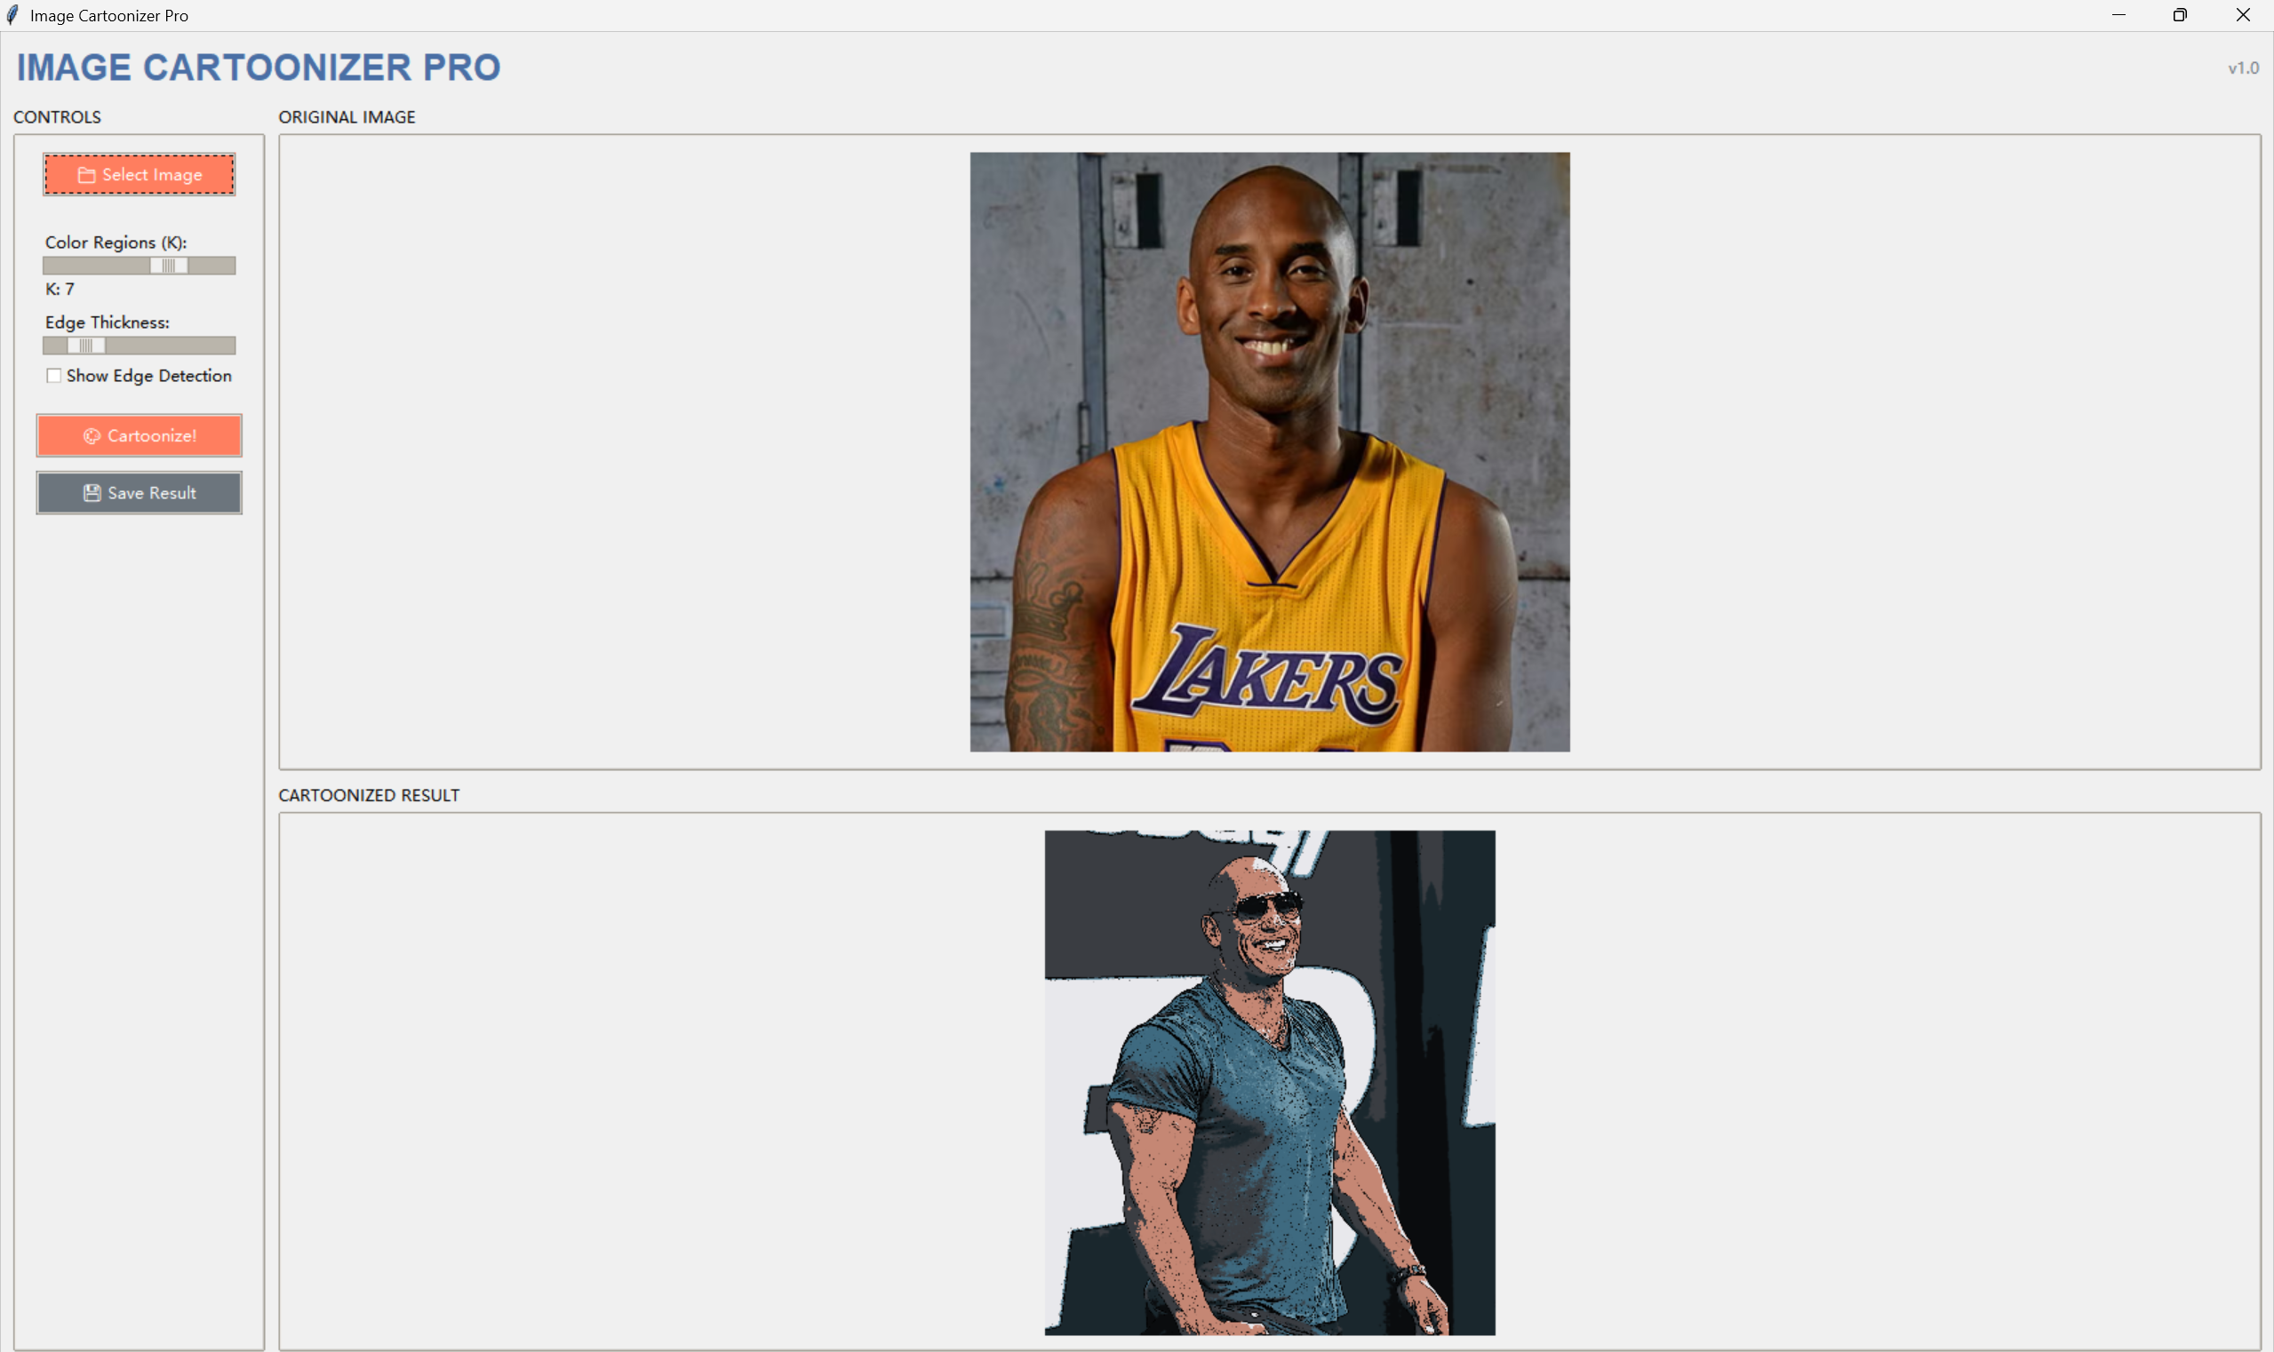
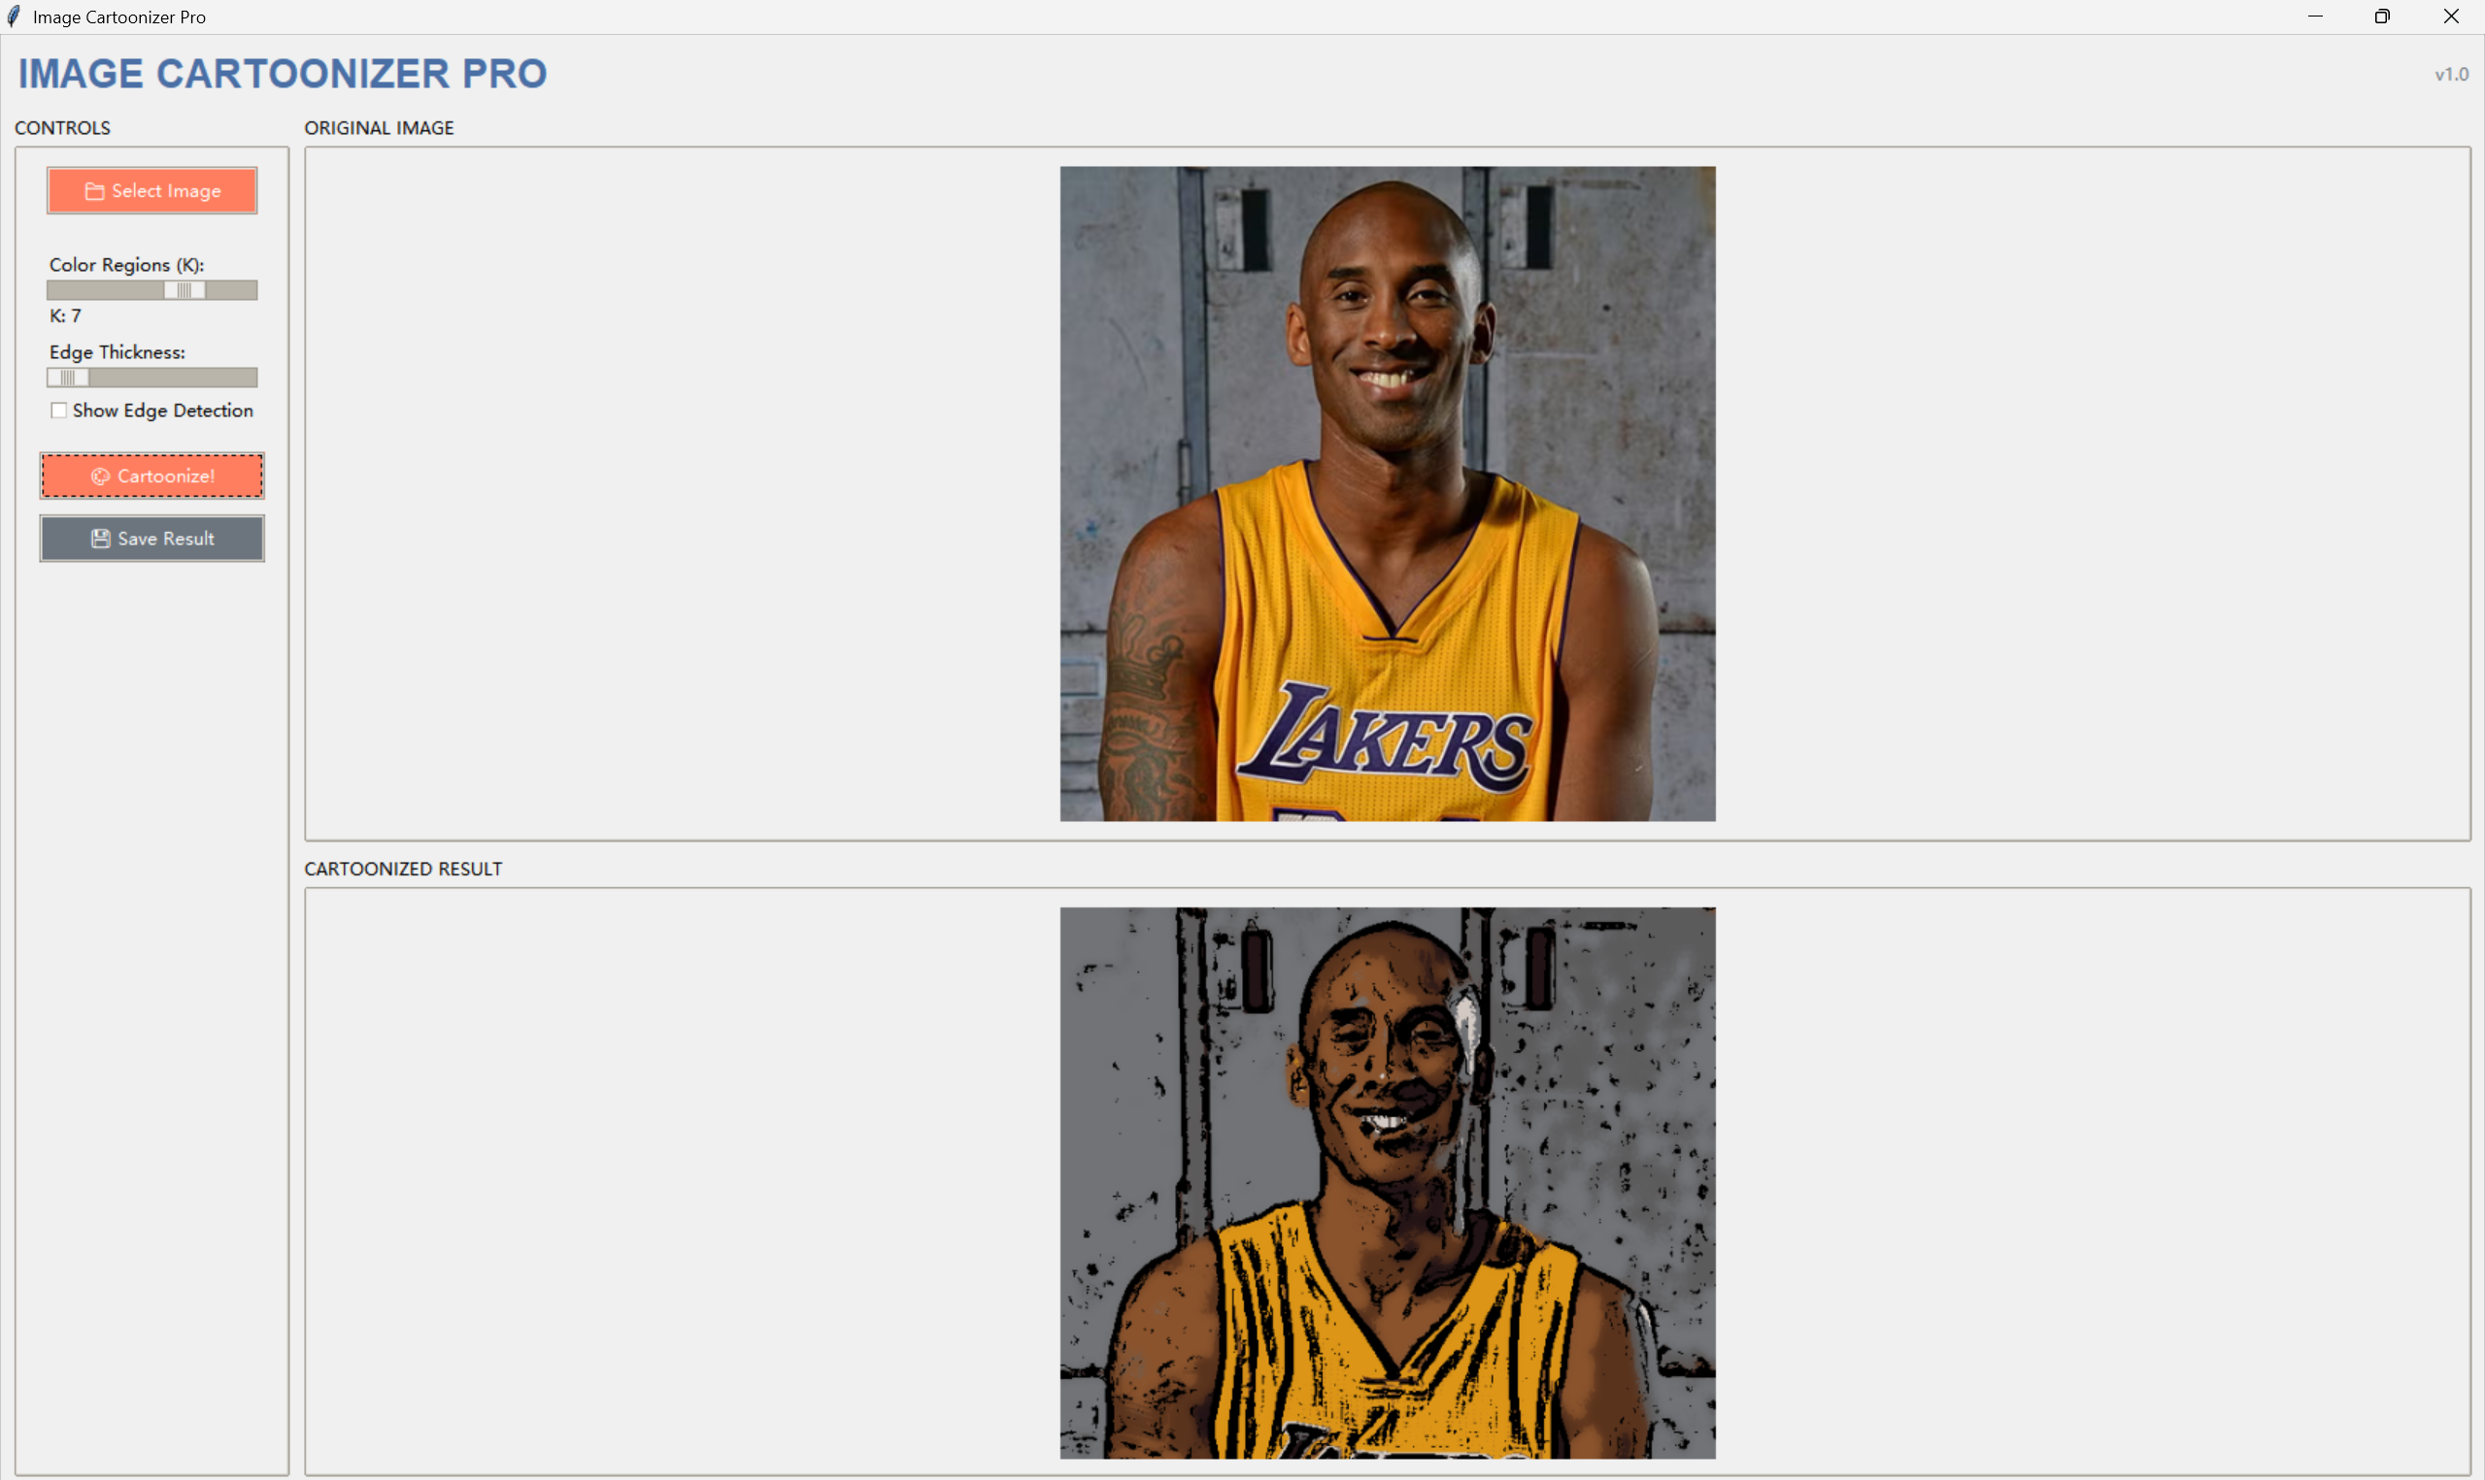
Result display update

Slide 12
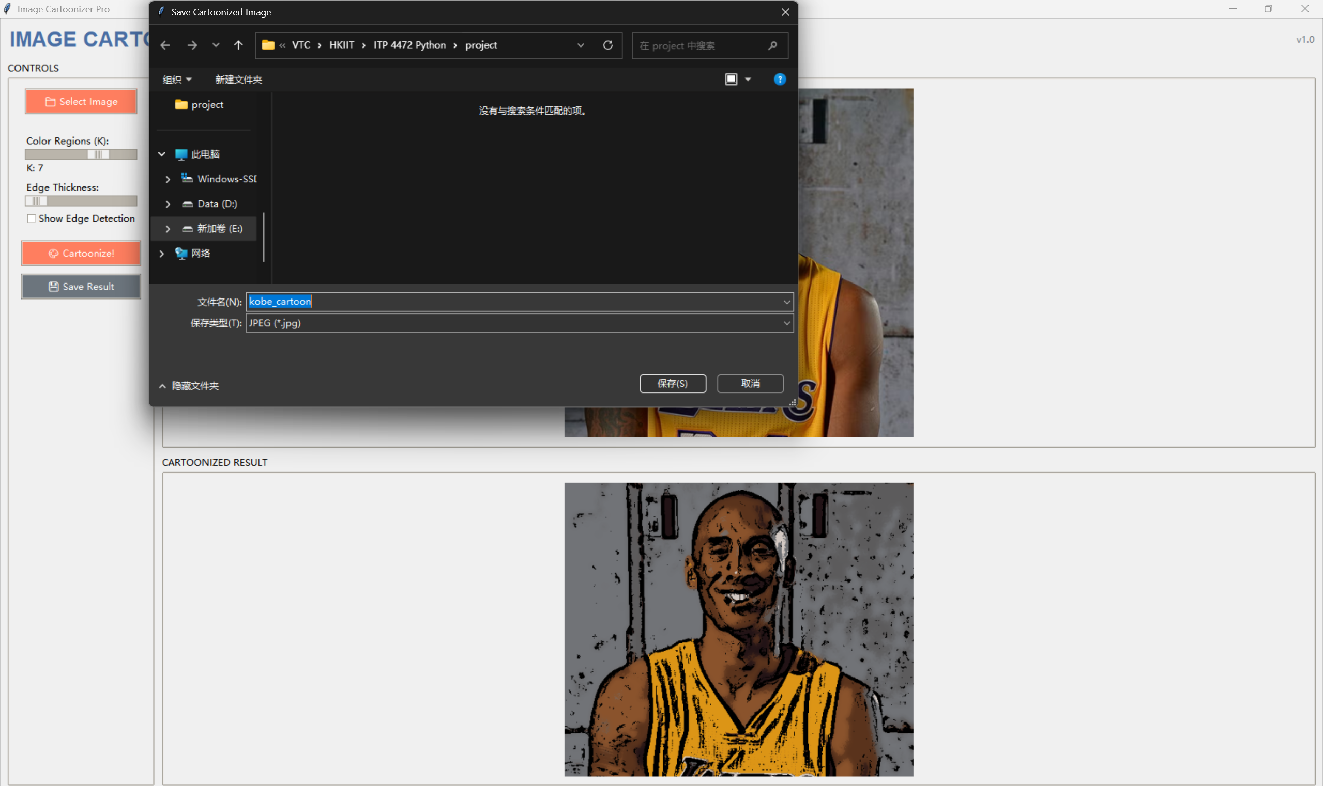
Result Saving

Slide 13
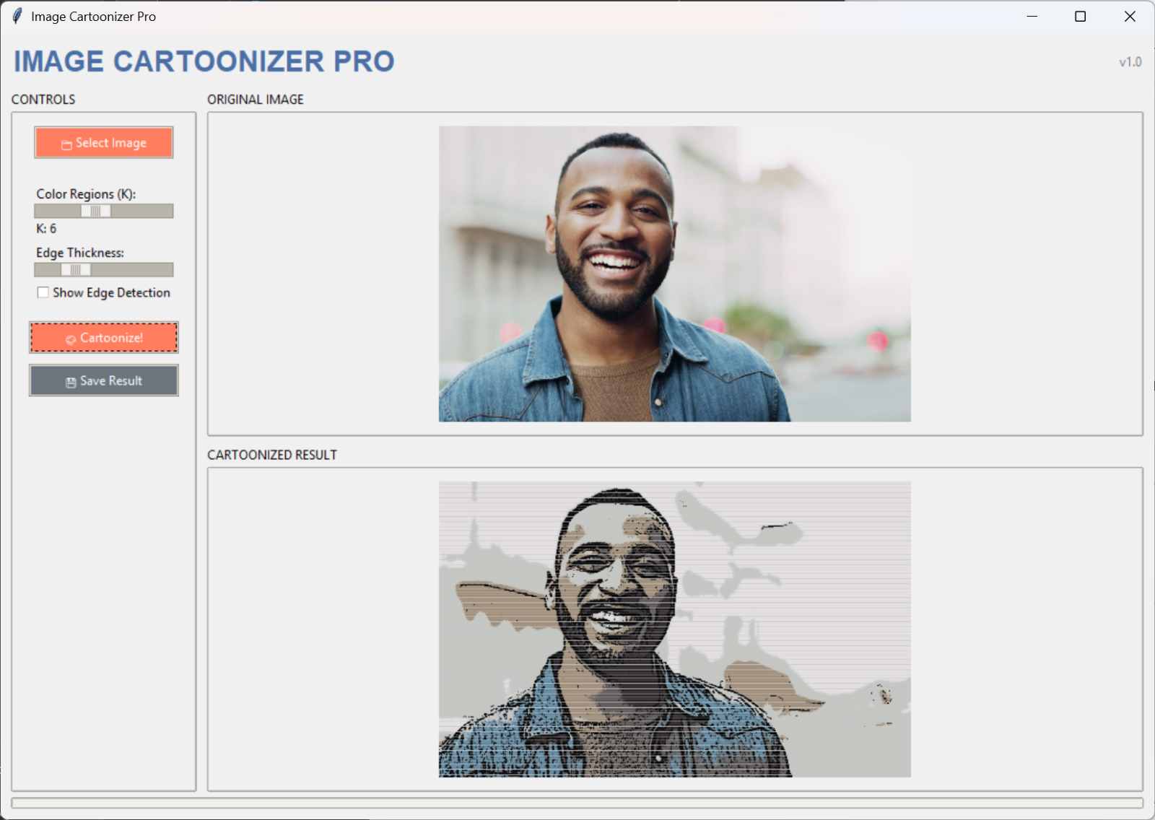
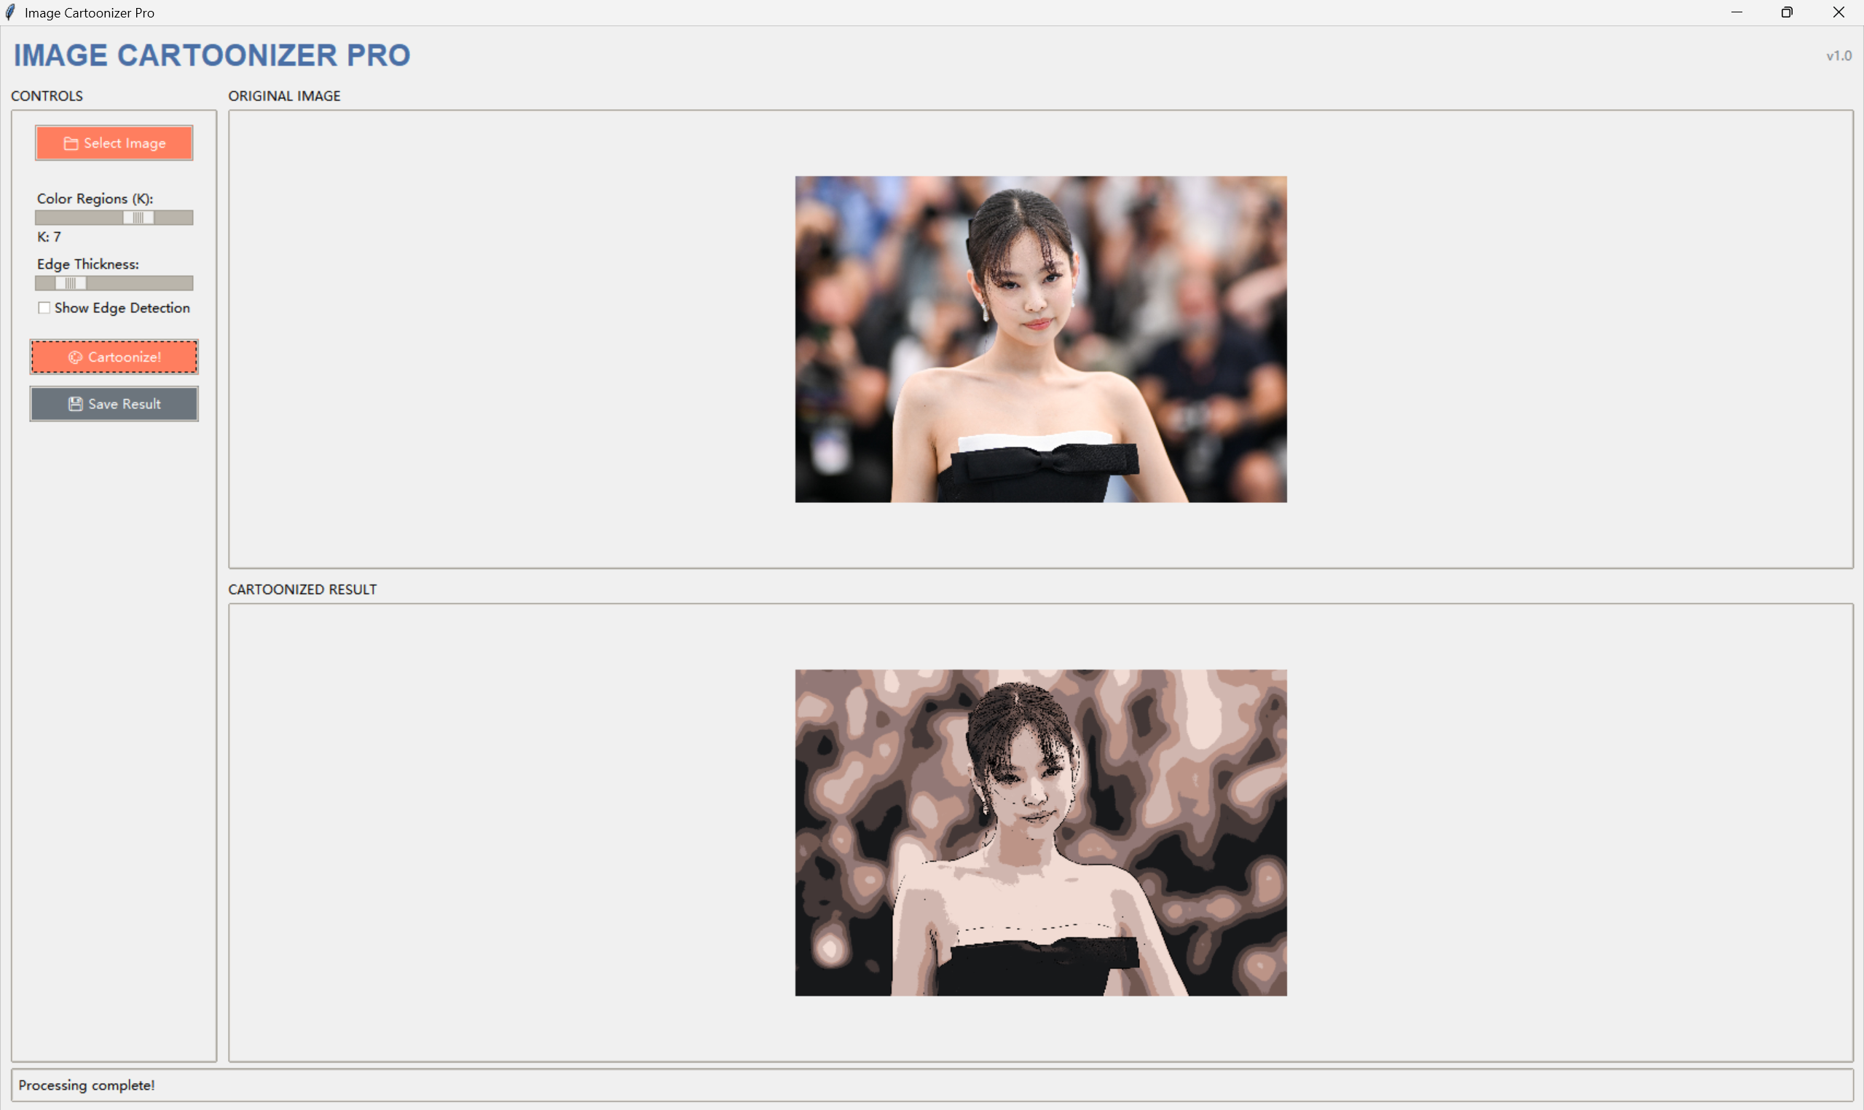
Sample Outcomes

Slide 14
THANKS

Slide 15
ANY QUESTIONS?

